Slide 1
HOW TO GET TREATMENT IN THE AMUR REGION
The Ministry of Health Care of the Amur Region

Slide 2
TREATMENT IN THE AMUR REGION - IS
HIGH QUALITY
(high quality medical care that meets international standards)
QUALIFIED DOCTORS
(highly trained doctors, nurses and other medical specialists with an international experience )
LOW COST
(medical care in Russia has an excellent cost-to-quality ratio)
CULTURE OF THE REGION
(discover rich national cultural heritage and history)

Slide 3
GETTING MEDICAL TREATMENT
In the Amur Region, you can get medical care on an outpatient
and inpatient basis.
OUTPATIENT
MEDICAL CARE
Get your health check-up within
2-3 days while you are on vacation
(сheck a healthcare facility website
for more information)
INPATIENT
MEDICAL CARE
Choose a health facility according to the medical procedure you are seeking and come to Russia for hospital admission
(сheck a healthcare facility website
for more information)

Slide 4
HOW TO GET TREATMENT IN THE AMUR REGION
STEP I:
Choose a health facility
STEP IV:
Apply for a visa
STEP II:
Get confirmation from chosen healthcare facility
STEP V:
Welcome to
Amur region!
STEP III:
Select type of transportation
and accommodation

Slide 5
Choose a health facility
STEP I

Slide 6
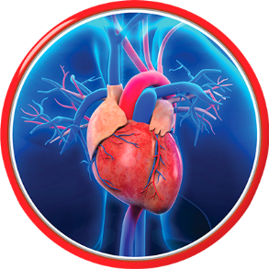
Medical care profiles and medical centers in the Amur Region CARDIOLOGY
(inpatient medical care)
State autonomous healthcare institution of the Amur region
"Amur regional clinical hospital", Blagoveshchensk
http://aokb28.su/
State autonomous healthcare institution of the Amur region "Blagoveshchensk city clinical hospital", Blagoveshchensk
http ://muzgkb.ru/
Cardiac surgery clinic of the federal state budgetary educational institution of higher education "Amur state medical academy" of the Ministry of Health Care of the Russian Federation, Blagoveshchensk
http ://www.amursma.ru/meditsina/klinika-kardiokhirurgii/

Slide 7
CARDIOLOGY
(outpatient medical care)
State autonomous healthcare institution of the Amur region
"City polyclinic № 1", Blagoveshchensk
https://www.clinicablg.ru/
State budgetary health institution of the Amur region
"City polyclinic № 2", Blagoveshchensk
http://gp2blag.ucoz.ru/
State autonomous healthcare institution of the Amur region
"City polyclinic № 3", Blagoveshchensk
http://www.polik3amur.ru/
State autonomous healthcare institution of the Amur region
"City polyclinic № 4", Blagoveshchensk
http://28gp4.ru/
State budgetary health institution of the Amur region
"City polyclinic of Svobodny", Svobodny
http://www.svbgp.ru/

Slide 8
CARDIOLOGY
(outpatient medical care)
State autonomous healthcare institution of the Amur region
"Belogorsk hospital", Belogorsk
http://www.xn----7sbbbcjn2aoifygbe1ar2h5e8b.xn--p1ai/
State budgetary health institution of the Amur region
"Zeya hospital named after B.E. Smirnova", Zeya
http://cbzeya.ru/
State budgetary health institution of the Amur region
"Raichikhinsk city hospital", Raichikhinsk
http://raigb.ru/
State autonomous healthcare institution of the Amur region
"Tynda hospital", Tynda
http://www.crb-t.ru/

Slide 9
GYNECOLOGY AND OBSTETRICS
(inpatient medical care)
State autonomous healthcare institution of the Amur region "Amur regional clinical hospital ", Blagoveshchensk
http://aokb28.su/
State autonomous healthcare institution of the Amur region "Blagoveshchensk city clinical hospital", Blagoveshchensk
http ://muzgkb.ru/

Slide 10
GYNECOLOGY AND OBSTETRICS
(outpatient medical care)
State autonomous healthcare institution of the Amur region
"City polyclinic № 1", Blagoveshchensk
https://www.clinicablg.ru/
State budgetary health institution of the Amur region
"City polyclinic № 2", Blagoveshchensk
http://gp2blag.ucoz.ru/
State budgetary health institution of the Amur region
"City polyclinic of Svobodny", Svobodny
http://www.svbgp.ru/

Slide 11
GYNECOLOGY AND OBSTETRICS
(outpatient medical care)
State autonomous healthcare institution of the Amur region
"Belogorsk hospital", Belogorsk
http://www.xn----7sbbbcjn2aoifygbe1ar2h5e8b.xn--p1ai/
State budgetary health institution of the Amur region
"Zeya hospital named after B.E. Smirnova", Zeya
http://cbzeya.ru/
State budgetary health institution of the Amur region
"Raichikhinsk city hospital", Raichikhinsk
http://raigb.ru/
State autonomous healthcare institution of the Amur region
"Tynda hospital", Tynda
http://www.crb-t.ru/

Slide 12
OPHTHALMOLOGY
(inpatient medical care)
State autonomous healthcare institution of the Amur region "Amur regional clinical hospital ", Blagoveshchensk
http://aokb28.su/
State autonomous healthcare institution of the Amur region "Blagoveshchensk city clinical hospital", Blagoveshchensk
http ://muzgkb.ru/

Slide 13
OPHTHALMOLOGY
(outpatient medical care)
State autonomous healthcare institution of the Amur region
"City polyclinic № 1", Blagoveshchensk
https://www.clinicablg.ru/
State budgetary health institution of the Amur region
"City polyclinic № 2", Blagoveshchensk
http://gp2blag.ucoz.ru/
State autonomous healthcare institution of the Amur region
"City polyclinic № 3", Blagoveshchensk
http://www.polik3amur.ru/
State autonomous healthcare institution of the Amur region
"City polyclinic № 4", Blagoveshchensk
http://28gp4.ru/
State budgetary health institution of the Amur region
"City polyclinic of Svobodny", Svobodny
http://www.svbgp.ru/

Slide 14
OPHTHALMOLOGY
(outpatient medical care)
State autonomous healthcare institution of the Amur region
"Belogorsk hospital", Belogorsk
http://www.xn----7sbbbcjn2aoifygbe1ar2h5e8b.xn--p1ai/
State budgetary health institution of the Amur region
"Zeya hospital named after B.E. Smirnova", Zeya
http://cbzeya.ru/
State budgetary health institution of the Amur region
"Raichikhinsk city hospital", Raichikhinsk
http://raigb.ru/
State autonomous healthcare institution of the Amur region
"Tynda hospital", Tynda
http://www.crb-t.ru/

Slide 15
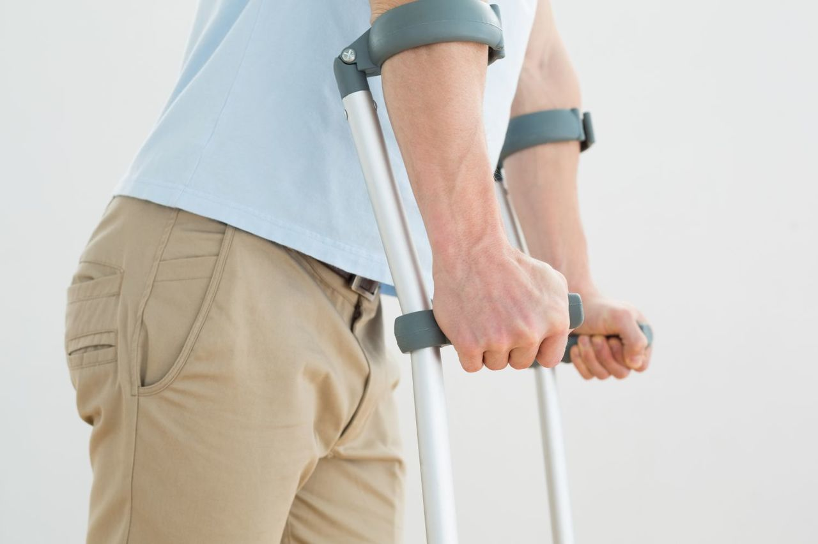
TRAUMATOLOGY AND ORTHOPEDICS
(inpatient and outpatient medical care)
State autonomous healthcare institution of the Amur region "Amur regional clinical hospital ", Blagoveshchensk
http://aokb28.su/
State autonomous healthcare institution of the Amur region "Blagoveshchensk city clinical hospital", Blagoveshchensk
http ://muzgkb.ru/

Slide 16
NEUROLOGY
(inpatient medical care)
State autonomous healthcare institution of the Amur region "Amur regional clinical hospital ", Blagoveshchensk
http://aokb28.su/
State autonomous healthcare institution of the Amur region "Blagoveshchensk city clinical hospital", Blagoveshchensk
http ://muzgkb.ru/

Slide 17
NEUROLOGY
(outpatient medical care)
State autonomous healthcare institution of the Amur region
"City polyclinic № 1", Blagoveshchensk
https://www.clinicablg.ru/
State budgetary health institution of the Amur region
"City polyclinic № 2", Blagoveshchensk
http://gp2blag.ucoz.ru/
State autonomous healthcare institution of the Amur region
"City polyclinic № 3", Blagoveshchensk
http://www.polik3amur.ru/
State autonomous healthcare institution of the Amur region
"City polyclinic № 4", Blagoveshchensk
http://28gp4.ru/
State budgetary health institution of the Amur region
"City polyclinic of Svobodny", Svobodny
http://www.svbgp.ru/

Slide 18
NEUROLOGY
(outpatient medical care)
State autonomous healthcare institution of the Amur region
"Belogorsk hospital", Belogorsk
http://www.xn----7sbbbcjn2aoifygbe1ar2h5e8b.xn--p1ai/
State budgetary health institution of the Amur region
"Zeya hospital named after B.E. Smirnova", Zeya
http://cbzeya.ru/
State budgetary health institution of the Amur region
"Raichikhinsk city hospital", Raichikhinsk
http://raigb.ru/
State autonomous healthcare institution of the Amur region
"Tynda hospital", Tynda
http://www.crb-t.ru/

Slide 19
NEUROSURGERY
(inpatient medical care)
State autonomous healthcare institution of the Amur region "Amur regional clinical hospital ", Blagoveshchensk
http://aokb28.su/

Slide 20
CHILDREN'S HEALTH
(inpatient and outpatient medical care)
State autonomous healthcare institution of the Amur region "Amur regional children's clinical hospital ", Blagoveshchensk
http://aodkb.ru/
State autonomous healthcare institution of the Amur region "Blagoveshchensk city children's clinical hospital", Blagoveshchensk
http://dgkbamur28.ru/

Slide 21
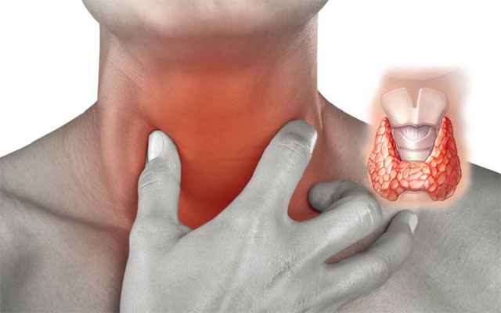
ENDOCRINOLOGY
(inpatient medical care)
State autonomous healthcare institution of the Amur region "Amur regional clinical hospital ", Blagoveshchensk
http://aokb28.su/
State autonomous healthcare institution of the Amur region "Blagoveshchensk city clinical hospital", Blagoveshchensk
http ://muzgkb.ru/

Slide 22
ENDOCRINOLOGY
(outpatient medical care)
State autonomous healthcare institution of the Amur region
"City polyclinic № 1", Blagoveshchensk
https://www.clinicablg.ru/
State budgetary health institution of the Amur region
"City polyclinic № 2", Blagoveshchensk
http://gp2blag.ucoz.ru/
State autonomous healthcare institution of the Amur region
"City polyclinic № 3", Blagoveshchensk
http://www.polik3amur.ru/
State autonomous healthcare institution of the Amur region
"City polyclinic № 4", Blagoveshchensk
http://28gp4.ru/
State autonomous healthcare institution of the Amur region "Amur regional clinical hospital ", Blagoveshchensk
http://aokb28.su/

Slide 23
THERAPY
(inpatient medical care)
State autonomous healthcare institution of the Amur region "Amur regional clinical hospital ", Blagoveshchensk
http://aokb28.su/
State autonomous healthcare institution of the Amur region "Blagoveshchensk city clinical hospital", Blagoveshchensk
http ://muzgkb.ru/

Slide 24
THERAPY
(inpatient medical care)
State autonomous healthcare institution of the Amur region
"Belogorsk hospital", Belogorsk
http://www.xn----7sbbbcjn2aoifygbe1ar2h5e8b.xn--p1ai/
State budgetary health institution of the Amur region
"Zeya hospital named after B.E. Smirnova", Zeya
http://cbzeya.ru/
State budgetary health institution of the Amur region
"Raichikhinsk city hospital", Raichikhinsk
http://raigb.ru/
State autonomous healthcare institution of the Amur region
"Tynda hospital", Tynda
http://www.crb-t.ru/

Slide 25
THERAPY
(inpatient medical care)
State budgetary health institution of the Amur region
"Svobodny hospital", Svobodny
http://www.svbhospital.ru/
State budgetary health institution of the Amur region "Central district hospital of Skovorodino", Skovorodino
http://skovzdrav.ru/
State budgetary health institution of the Amur region "Shimanovsk hospital", Shimanovsk
http://medshim.amur.medobl.ru/

Slide 26
THERAPY
(outpatient medical care)
State autonomous healthcare institution of the Amur region
"City polyclinic № 1", Blagoveshchensk
https://www.clinicablg.ru/
State budgetary health institution of the Amur region
"City polyclinic № 2", Blagoveshchensk
http://gp2blag.ucoz.ru/
State autonomous healthcare institution of the Amur region
"City polyclinic № 3", Blagoveshchensk
http://www.polik3amur.ru/
State autonomous healthcare institution of the Amur region
"City polyclinic № 4", Blagoveshchensk
http://28gp4.ru/
State budgetary health institution of the Amur region
"City polyclinic of Svobodny", Svobodny
http://www.svbgp.ru/

Slide 27
THERAPY
(outpatient medical care)
State autonomous healthcare institution of the Amur region
"Belogorsk hospital", Belogorsk
http://www.xn----7sbbbcjn2aoifygbe1ar2h5e8b.xn--p1ai/
State budgetary health institution of the Amur region
"Zeya hospital named after B.E. Smirnova", Zeya
http://cbzeya.ru/
State budgetary health institution of the Amur region
"Raichikhinsk city hospital", Raichikhinsk
http://raigb.ru/
State autonomous healthcare institution of the Amur region
"Tynda hospital", Tynda
http://www.crb-t.ru/
State budgetary health institution of the Amur region "Shimanovsk hospital", Shimanovsk
http://medshim.amur.medobl.ru/

Slide 28
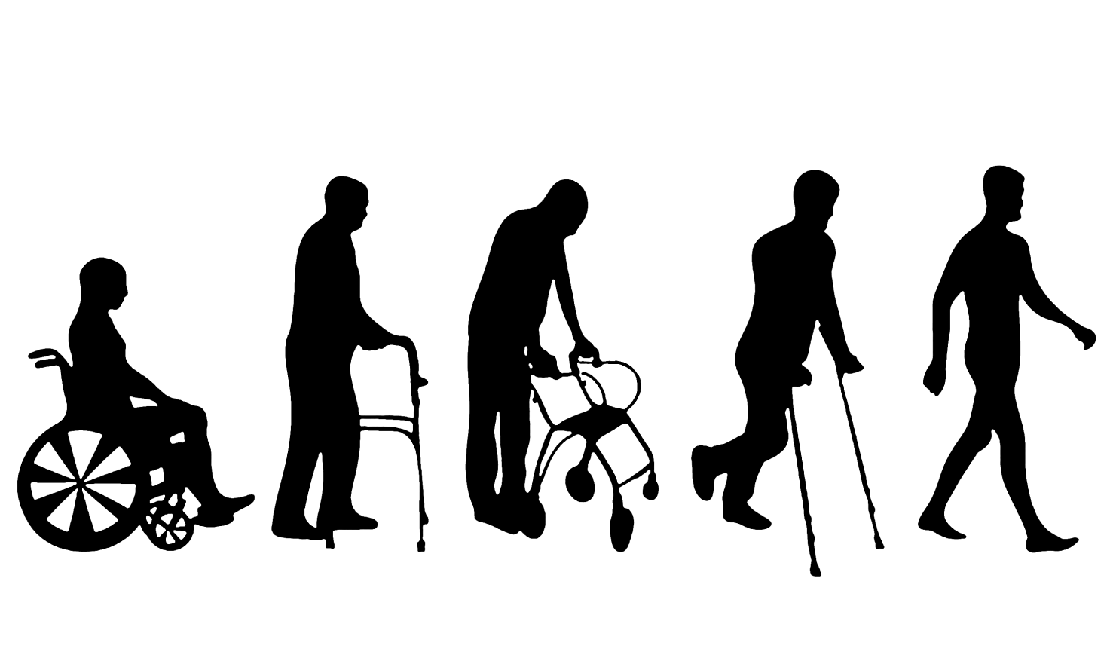
REHABILITATION
State autonomous healthcare institution of the Amur region "Rehabilitation hospital", Blagoveshchensk
https://sbis.ru/contragents/2801243707/280101001
State autonomous healthcare institution of the Amur region “Hospital of Ivanovka", Ivanovka
http ://www.ivancrb.ru/

Slide 29
CONTACT A SPECIALIST FROM YOUR CHOSEN HEALTH FACILITY TO DECIDE ON THE FORM OF MEDICAL TREATMENT YOU NEED AND FOR PREPARING DOCUMENTS FOR YOUR VISIT TO amur region
STEP II

Slide 30
1. Check the section "medical tourism” on the health care facility web-site;
2. Read the information;
3. Make a request through a phone call or email;
4. Get a confirmation for treatment and follow the instructions to apply for a visa.

Slide 31
SELECT THE BEST TYPE OF TRANSPORTATION AND ACCOMMODATION
STEP III

Slide 32
TRANSPORTATION
If you arrived in Blagoveshchensk
by plane:
Blagoveshchensk
PUBLIC TRANSPORTATION
Bus routes and timetables:
busblg.ru
Ignatievo International Airport
TAXI
Order a taxi through the application on your mobile phones: yandex.taxi;
or order a taxi through the site: vse-taxi.com.

Slide 33
TRANSPORTATION
If you arrived in Blagoveshchensk
by train:
Blagoveshchensk
Railway station of Blagoveshchensk
TAXI
Order a taxi through the application on your mobile phones: yandex.taxi;
or order a taxi through the site: vse-taxi.com.
PUBLIC TRANSPORTATION
Bus routes and timetables:
busblg.ru

Slide 34
ACCOMMODATION
ACCOMMODATION OPTIONS IF YOU ARE COMING FOR OUTPATIENT ADMISSION
Please contact a tour operator or assistance companies if you need any assistance with organizing your trip.
https://www.booking.com/
https://www.tripadvisor.com/
https://www.airbnb.com/
ACCOMMODATION OPTIONS IF YOU ARE COMING FOR INPATIENT ADMISSION
Contact a specialist from a health facility for information about your accommodation. Please do not forget to do it in advance.

Slide 35
Apply for a visa
STEP IV

Slide 36
SELECTION OF TYPE OF VISA AND DETERMINATION OF THE PURPOSE OF RESIDENCE
Type of visa: TOURIST
Purpose of visit:
TARGET TOURISM
The period of validity up to 30 days
For those who visit Russia for tourism purposes on a specialized tour for health check-ups or medical consultations
Type of visa :
BUSINESS
Purpose of visit :
MEDICAL TREATMENT
The period of validity: up to 90 days
For those who visit Russia for medical treatment, health check-ups, medical advice with official invitation obtained from a health facility (except target tourism for the purpose of treatment and critical care).
Type of visa :
PRIVATE
Purpose of visit :
SPECIAL CASES
The period of validity: up to 90 days
For those who travel to Russia for emergency medical treatment or to visit a sick relative.

Slide 37
HELP WITH PROCESSING DOCUMENTS FOR ENTERING RUSSIA
GETTING AN OFFICIAL INVITATION
Once you get an approval for treatment, the health facility should obtain an official invitation and submit your documents to the Federal Migration Service of Russia in order to register your migration.
APPLYING THROUGH TRAVEL AGENCIES
OR TRAVEL ASSISTANCE COMPANIES
In case you need additional help with applying for a Russian visa, you can contact travel agencies or travel assistance companies.

Slide 38
WELCOME TO AMUR REGION!
STEP V

Slide 39
EMERGENCY TELEPHONE NUMBERS
EMERGENCY
112
FEDERAL MIGRATION SERVICE OF RUSSIA
8 (800) 350 23 69
*381
POLICE
8 (800) 222 74 47

Slide 40
CONTACT INFORMATION
EXPORT OF MEDICAL SERVICES COORDINATION CENTER FEDERAL RESEARCH INSTITUTE FOR HEALTH ORGANIZATION AND INFORMATICS OF THE MINISTRY OF HEALTH OF THE RUSSIAN FEDERATION
127256,
MOSCOW, DOBROLYUBOVA ST., 11
E-MAIL:
OM@ROSMINZDRAV.RU
PHONE NUMBERS:
+7 (495) 618-07-92, *103
+7 (495) 618-07-92, *104

Slide 41
Thanks for attention!
zdrav@amurobl.ru

